Slide 1

ICT 171: Assignment - 2
Cloud Project
Food Ordering Website
Name : Gilchrist Candido Tavares
Student ID : 35011841
Domain name : www.gilfoodiehub.live
IP : 52.166.192.249

Slide 2
Table of Contents
No | Topic | Page
1 | Creating the server | 1
2 | Connecting to the server | 1
3 | Installing Necessary Modules | 1
4 | Creating the domain | 2
5 | Configuring SSL | 3
6 | Setting up the Database | 5
7 | Configuring the main server | 8

Slide 3
Creating the Server
Create an Ubuntu Instance on AWS, Azure, etc .with a minimum of 1 CPU and 1 GB RAM
Open ports 22,80,443 to allow SSH HTTP(S) traffic to your server.
Note the public IP address
Download the ssh-key pair file on your system
Connecting to the Server
To connect to our server we'll be using OpenSSH which is available in most Windows System. The command is :
Installing Necessary modules
Our Server uses nginx to route traffic to our local server with SSL , NodeJS runtime to host our Express.js Server
To confirm the installation, the following commands should return the version of the package installed
To download our project code, we use git to clone our Github repository. After navigating into the folder, we use npm to install our project dependencies (express.js, supabase.js)
We also use pm2, which is a process manager for Node.JS to ensure our server is running and logs any errors
ssh –i 'path/to/file' username@public-ip
sudo apt update
sudo apt install nginx snapd git
sudo snap install node --classic
nginx -v git --version
node -v snap --version
git clone https://github.com/Agentgilspy/Food-Ordering-Website
cd Food-Ordering-Website
npm install
sudo npm install pm2 –g # pm2 –v to confirm the installation

Slide 4
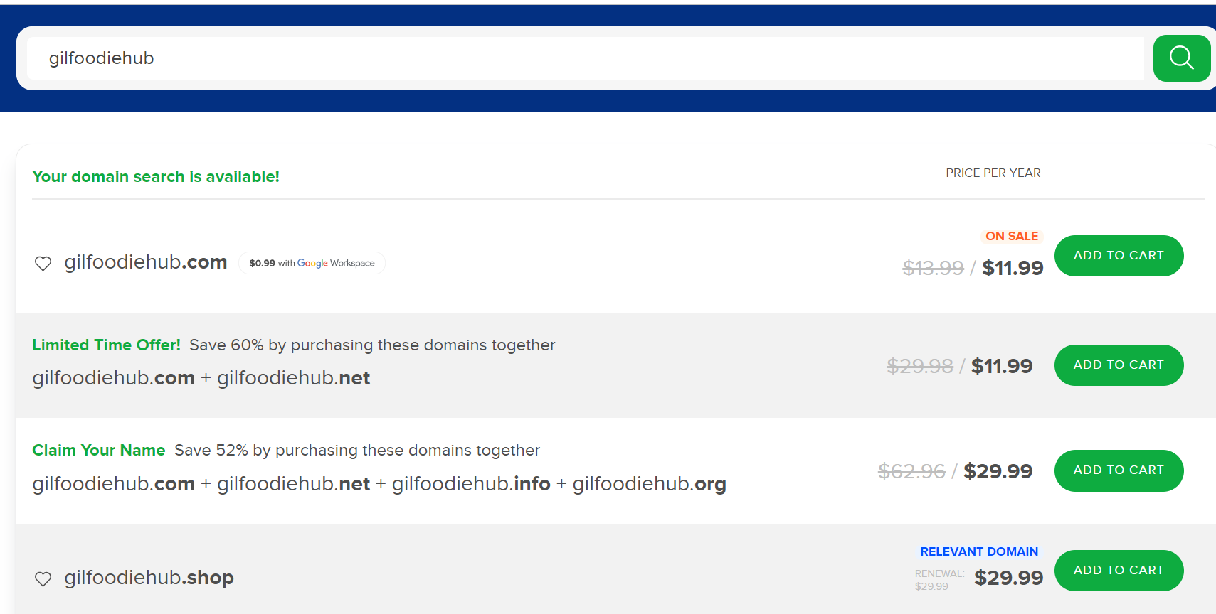
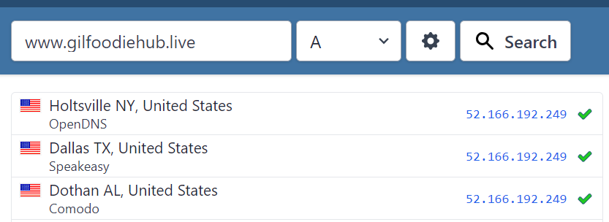
Creating the domain
I have decided to use name.com for this project, but the procedure should be similar across all DNS providers
Go to name.com, search for the desired domain, and purchase it
After purchasing the domain, go to My Domains
Go to your domain settings > Manage DNS records
Add a type A record, leaving the host field blank, and enter your IP in the answer field
www.gilfoodiehub.live will now point to our IP (52.166.192.249)
DNS records can take up to a few hours to update. We can use www.whatismydnsnet to perform lookup on multiple name servers

Slide 5
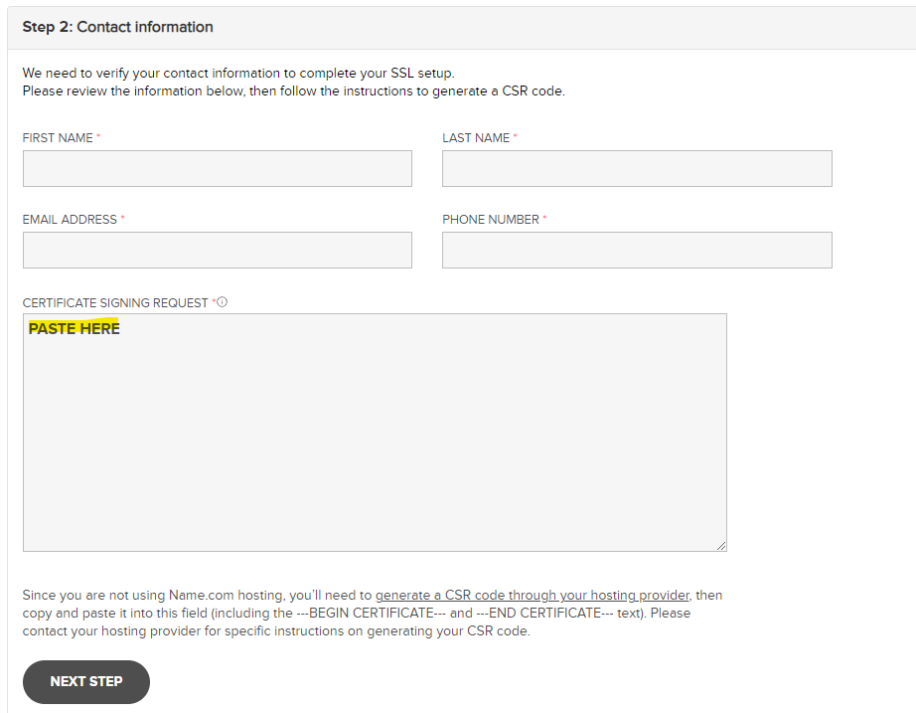
Configuring SSL
We use OpenSSL to generate our SSL key and certificate signing request(CSR), which we provide to our domain provider to get a signed SSL certificate
In our project folder, we create an SSL folder and navigate into it. Then, we use the following commands to generate the key and CSR file
You will be asked to fill in some details while generating a CSR
Using the cat command, you need to copy the contents of domain.csr
For this project, I was using Name.com, which offers an option to generate SSL certificates
Paste the contents of domain.csr in the form and fill in the details
Name.com will provide you with the contents of your certificate file , you need to copy it and paste it into our server
mkdir ssl
cd ssl
openssl genrsa -out privkey.key
openssl req -key privkey.key -new -out domain.csr
cat domain.csr
nano domain.crt # Paste the content and save the file

Slide 6
Configuring SSL
To configure nginx to use our SSL files, we need to create a config file
To confirm our config has no errors and to reload nginx so it can use our config, we need to run the following commands
cd /etc/nginx/conf.d/
sudo nano server.conf
#Paste the following
server {
listen 443 ssl;
server_name gilfoodiehub.live;
# Path may vary
ssl_certificate /home/gilchrist/Project/ssl/domain.crt;
ssl_certificate_key /home/gilchrist/Project/ssl/privkey.key;
# Our Express server is running on port 3000
# so we use nginx reverse proxy feature to route
# connections from port 443 to 3000
location / {
proxy_pass http://127.0.0.1:3000;
}
}
# The Following block redirects http to https
server {
listen 80;
server_name gilfoodiehub.live;
location / {
return 301 https://gilfoodiehub.live;
}
}
sudo nginx –t # Should Respond with a success message
sudo nginx –s reload

Slide 7
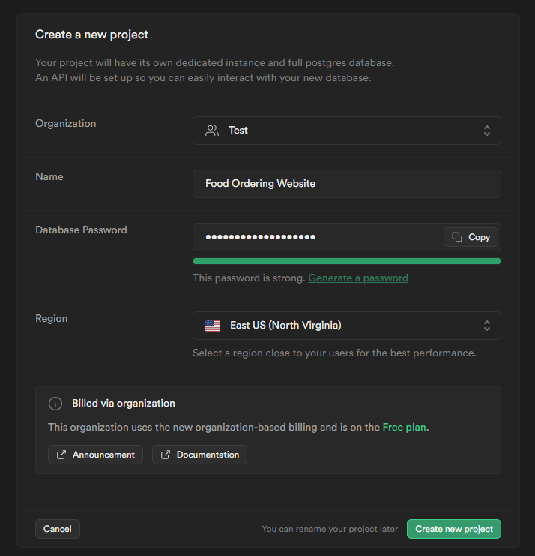
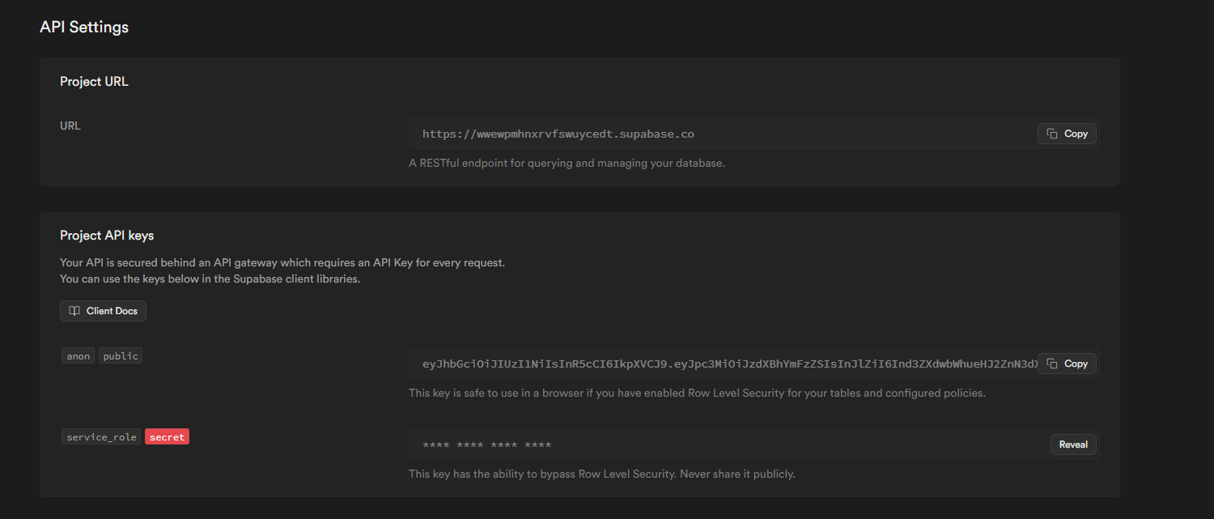
Setting up the Database
For this project, I have decided to use Supabase as a database, It is an open-source PostgreSQL database, and there is an option to locally host the database but due to the performance requirements, it would not be cost-effective to run the database ourselves at a small scale so I have decided to use supabase's free tier
Create an account with Supabase, create a new project
After creating the project, go to the Project Settings > API
You must note the URL, public key, service role, and JWT secret. These are essential to allow client and server interactions with the database. These values will be stored in a config file
To create the tables that store our data, Go to SQL Editor. You will find a panel that will let you run SQL commands, and we will use this to create our tables. You can also use the UI to create the tables, which is what I did, but running the commands is faster
It is required that the commands are run the same order as they are displayed

Slide 8
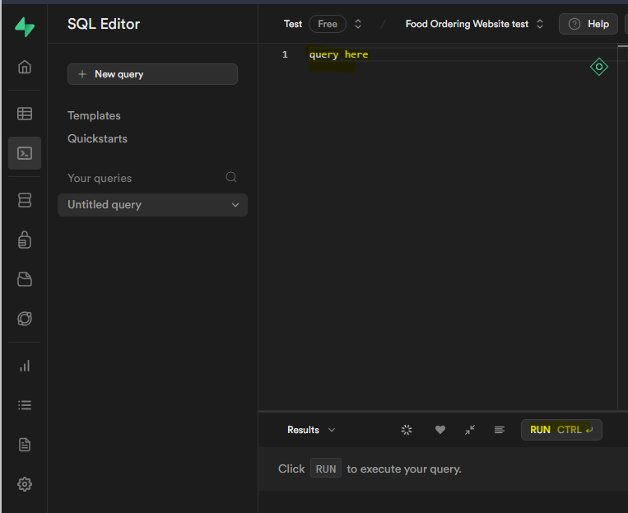
Setting up the Database
create table
public.users (
uid uuid not null,
email character varying not null,
full_name character varying not null,
phone_num character varying not null,
constraint users_pkey primary key (uid),
constraint users_uid_fkey foreign key (uid) references auth.users (id) on update cascade on delete cascade
) tablespace pg_default;
create table
public.menu (
item_id text not null,
item_name character varying not null,
type character varying not null,
description character varying not null,
price numeric not null,
image character varying null,
constraint menu_pkey primary key (item_id)
) tablespace pg_default;
create table
public.orders (
order_id bigint generated by default as identity,
uid uuid not null,
"placedAt" timestamp with time zone not null default now(),
cart json not null,
address text not null,
status numeric not null default '1'::numeric,
constraint orders_pkey primary key (order_id),
constraint orders_uid_fkey foreign key (uid) references users (uid) on update cascade on delete cascade
) tablespace pg_default;

Slide 9
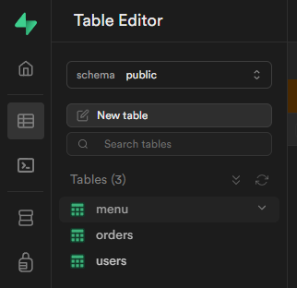
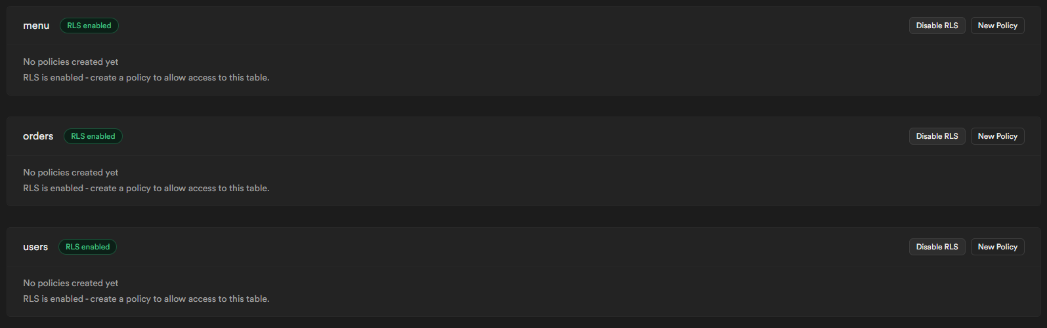
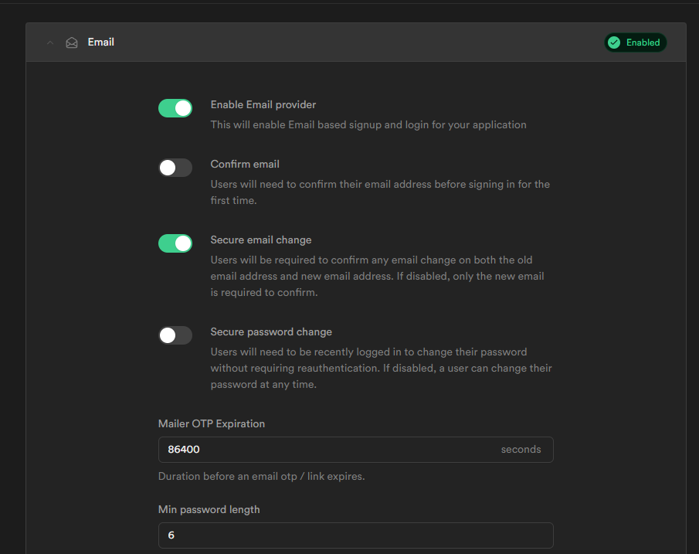
Setting up the Database
To confirm that the tables were created, go to Table Editor, and the tables should be there
We need to enable Row Level Security, a feature that prevents clients from gaining full access to the database. Under Authentication > Policies, Enable RLS for all tables, and it should look like this
To allow users to create accounts with us, we need to enable email authentication, which can be found under Authentication > Providers > Email and enable email provider. Your settings should look like this

Slide 10
Configuring the main server
I have used a config.json, supabase.js file to store my project URL, public key, service role, and port, as it is easier to update a config file rather than the code
In the directory of the project, run the following commands to edit the config files and paste the project URL, public key, service role, and JWT secret in the ""
To initiate the server, use the following command
PM2 should respond with a success message, the logs of the application can be monitored using
If the server is running, this should be your output
The server also logs actions like account order creations.
nano config.json
nano supabase.js
pm2 start app.js
pm2 logs app

